Slide 1
Splash Screen

Slide 2
Lesson Menu
Five-Minute Check (over Lesson 4–4)
Then/Now
New Vocabulary
Example 1: Solve a Two-Step Equation
Example 2: Solve a Two-Step Equation
Example 3: Equations with Negative Coefficients
Example 4: Combine Like Terms Before Solving
Example 5: Standardized Test Example

Slide 3
5-Minute Check 1
A. 24
B. –12
C. –18
D. –24

Slide 4
5-Minute Check 2
Solve –3x = –21. Check your solution.
A. 9
B. 7
C. –7
D. –8

Slide 5
5-Minute Check 3
A. 38
B. 36
C. 34
D. 32

Slide 6
5-Minute Check 4
Solve –28 = 4x. Check your solution.
A. –7
B. –8
C. –9
D. –32

Slide 7
5-Minute Check 5
A. –48
B. –45
C. –38
D. –32

Slide 8
5-Minute Check 6
Which number line shows the solution for –8 = 4x?
A.
B.
C.
D.

Slide 9
Then/Now
You have already solved one-step equations. (Lessons 4–3 and 4–4)
Solve two-step equations.
Solve real-world problems involving two-step equations.

Slide 10
Vocabulary
two-step equation

Slide 11
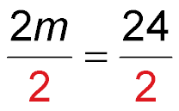
Example 1
Solve a Two-Step Equation
Solve 2m + 8 = 32. Check your solution.
Method 1 The Vertical Method
2m + 8 = 32 Write the equation.
– 8 = – 8 Subtraction Property of Equality
2m = 24 Simplify.
Division Property of Equality
m = 12 Simplify.

Slide 12
Example 1
Solve a Two-Step Equation
Method 2 The Horizontal Method
2m + 8 = 32 Write the equation.
2m + 8 – 8 = 32 – 8 Subtraction Property of Equality
2m = 24 Simplify.
Division Property of Equality
m = 12 Simplify.
Answer: The solution is 12.

Slide 13
Example 1
Solve 5b + 4 = 79.
A. –70
B. –15
C. 15
D. 70

Slide 14
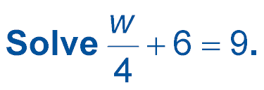
Example 2
Solve a Two-Step Equation
Write the equation.
Subtraction Property of Equality
Simplify.
Multiplication Property of Equality
w = 12 Simplify.
Answer: The solution is 12.

Slide 15
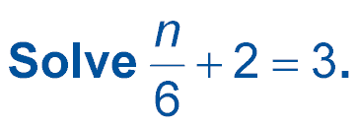
Example 2
A. 1
B. 6
C. 12
D. 30

Slide 16
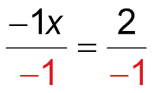
Example 3
Equations with Negative Coefficients
Solve 5 – x = 7.
5 – x = 7 Write the equation.
5 – 1x = 7 Identity Property; x = 1x
5 + (–1x) = 7 Definition of subtraction
–5 + 5 + (–1x) = –5 + 7 Add –5 to each side.
–1x = 2 Simplify.
Divide each side by –1.
x = –2 Simplify.
Answer: The solution is –2.

Slide 17
Example 3
Solve 9 = –4 – m.
A. 13
B. 5
C. –5
D. –13

Slide 18
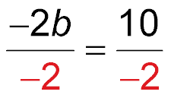
Example 4
Combine Like Terms Before Solving
Solve b – 3b + 8 = 18. Check your solution.
b – 3b + 8 = 18 Write the equation.
1b – 3b + 8 = 18 Identity Property; b = 1b
–2b + 8 = 18 Combine like terms, 1b and –3b.
–2b + 8 – 8 = 18 – 8 Subtract 8 from each side.
–2b = 10 Simplify.
Divide each side by –2.
b = –5 Simplify.
Answer: The solution is –5.

Slide 19
Example 4
Solve 9 = 13 – x + 5x.
A. 1
B.
C.
D. –1

Slide 20
Example 5
Marissa wants to go to summer camp. The camp costs $229. She paid a deposit of $75, and she will need to save $14 per week to pay for the trip. The equation 75 + 14w = 229 can be used to find how many weeks Marissa will need to save. Which series of steps can be used to solve the equation?
A Divide 229 by 14. Then subtract 75.
B Subtract 14 from 229. Then divide by 75.
C Subtract 75 from 229. Then divide by 14.
D Subtract 229 from 75. Then divide by 75.

Slide 21
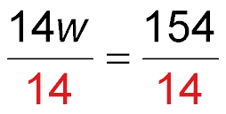
Example 5
Read the Test Item Solve the equation so that you can write the steps in the correct order that are necessary to solve the problem.
Solve the Test Item
75 + 14w = 229 Write the equation.
75 – 75 + 14w = 229 – 75 Subtraction Property of Equality
14w = 154 Simplify.
Division Property of Equality
w = 11 Simplify.

Slide 22
Example 5
Answer: To solve the equation, you first subtract 75 and then divide by 14. The correct answer is C.
Check
When you solve an equation, you undo the steps in evaluating an expression in reverse order of the order of operations. In this equation, you would first undo adding 75 by subtracting 75, then undo multiplying by 14 by dividing by 14.

Slide 23
Example 5
Adrienne is saving to buy a new MP3 player that costs $125. She has a summer job where she earns $6 per hour. She already has $17. The equation 17 + 6h = 125 can be used to find how many hours Marissa will need to work to pay for her player. Which series of steps can be used to solve the equation?
A. Divide 125 by 6. Then subtract 17.
B. Subtract 6 from 125. Then divide by 17.
C. Subtract 17 from 125. Then divide by 6.
D. Subtract 125 from 17. Then divide by 17.

Slide 24
End of the Lesson

